Slide 1
Global vs Local Variables in Python
DVT101 – Lecture 12
- By Dataverse Tutorials

Slide 2
Introduction to Variables Scope in Python
What are variables in Python
Why scope of variables matters
Introduction to Local and Global variables
Common beginner mistakes

Slide 3
What is Variable Scope?
Scope defines variable accessibility
Python follows LEGB rule
Local and Global are most common
Scope prevents data conflicts

Slide 4
Local Variables in Python
Defined inside a function
Exists only during function execution
Cannot be accessed outside
Stored in function memory

Slide 5
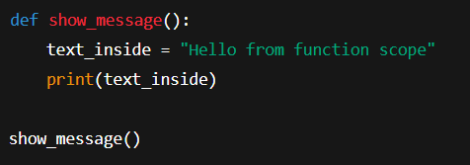
Local Variable Example – Inside Function
Local variables are created inside functions
Accessible only within the function
Destroyed after function execution
Helps in data isolation

Slide 6
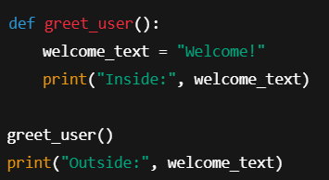
Why Local Variables Cannot Be Used Outside
Local variables cannot be accessed outside
Causes NameError
Scope limitation example
Common beginner mistake

Slide 7
Global Variables in Python
Defined outside all functions
Accessible everywhere
Stored in global namespace
Shared across functions

Slide 8
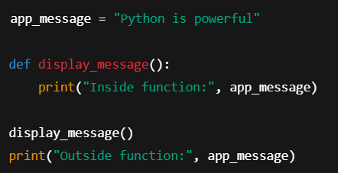
Using Global Variable Inside Function
Global variables defined outside functions
Accessible inside functions
Same memory reference used
No duplication

Slide 9
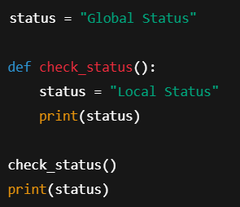
Local Variable Shadows Global Variable
Same name local and global variable
Local variable gets priority
Global remains unchanged
Known as shadowing

Slide 10
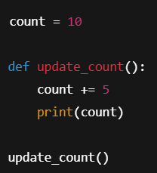
Why Global Cannot Be Modified Directly
Direct modification not allowed
Python treats variable as local
Causes UnboundLocalError
Needs global keyword

Slide 11
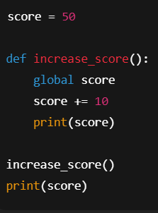
Using global Keyword Safely
global keyword links global variable
Allows modification
Changes persist outside function
Use carefully

Slide 12
Industry Use Cases
Configuration variables
Model parameters
Logging levels
Environment flags

Slide 13
Summary & Key Takeaways
Local variables are function-specific
Global variables are program-wide
Shadowing is common mistake
global keyword modifies global safely

Slide 14


